Slide 1


Nasa mission control: end of week overview

Slide 2

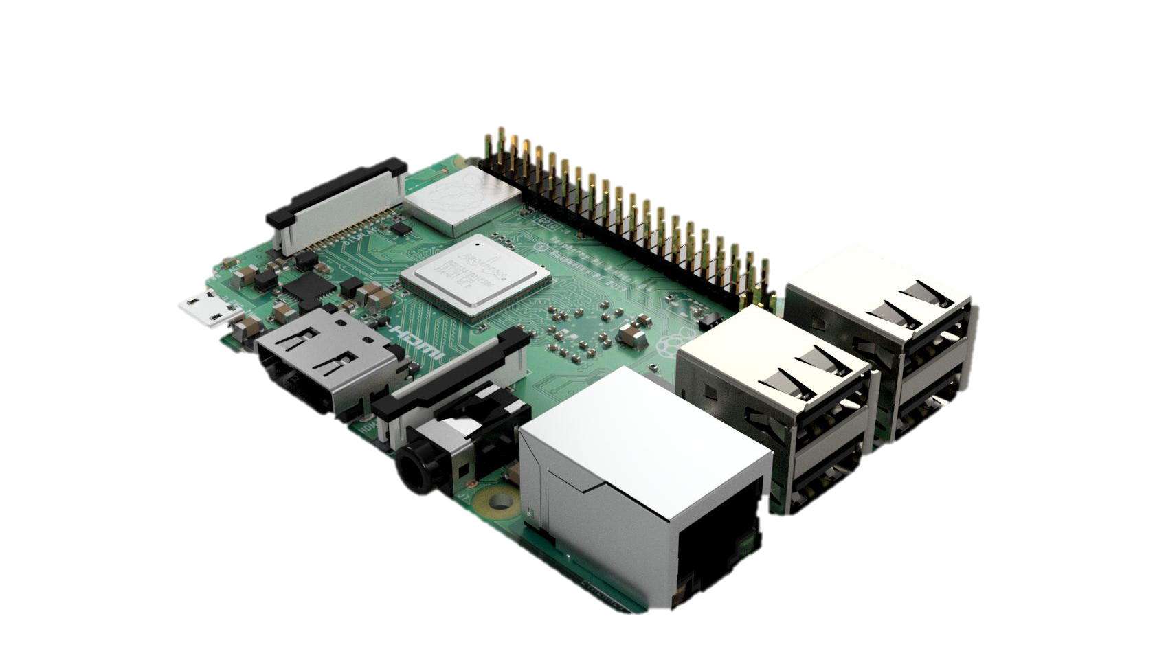
What HAVE WE LEARNED ABOUT RASPBERRY PI?
RASPBERRY PI
WHAT IT IS
HOW TO INTERACT WITH IT
CONTROLLING DIRECTORIES
BASIC LINUX COMMANDS
SSH AND SFTP
REMOTE COMMUNICATIONS ACROSS THE LAN
BASIC NETWORKING KNOWLEDGE

Slide 3

WHAT HAVE WE LEARNED ABOUT PYTHON?
PROGRAMMING WITH PYTHON
MAD LIBS GAME
ADVENTURE BOOK GAME
MORSE CODE GAME
MORSE CODE TRANSLATOR
SCRIPTS TO CONTROL CIRCUITRY
SCRIPTS THAT ACCESS APIs

Slide 4
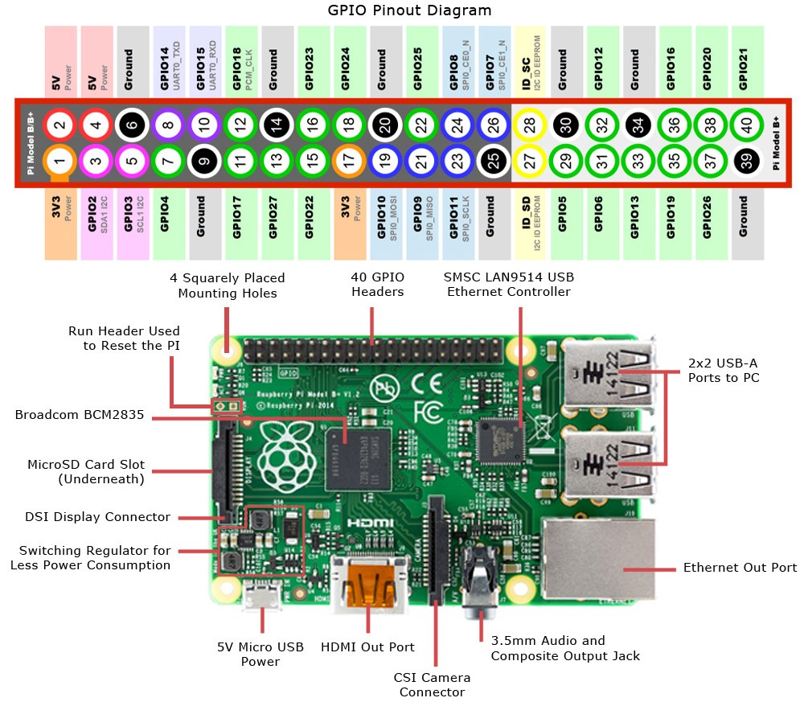
WHAT HAVE WE LEARNED ABOUT HARDWARE?
BUILDING BASIC CIRCUITS
HOW A BREADBOARD WORKS
RASPBERRY PI GPIO
ELECTRONIC DEVICES AND THEIR USES
TURNING ON AN LED
BLINKING AN LED WITH A BUTTON
LINKING A BUTTON TO A BUZZER

Slide 5
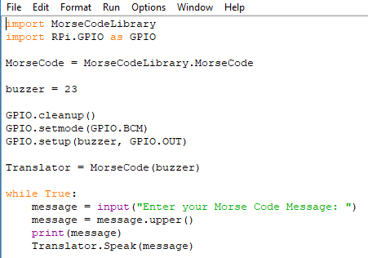
WHAT HAVE WE LEARNED ABOUT SOFTWARE?
VARIABLES
DATA TYPES
FUNCTIONS AND METHODS
CLASSES AND OBJECTS
LOGICAL STATEMENTS
LOOPS
DATA STRUCTURES

Slide 6
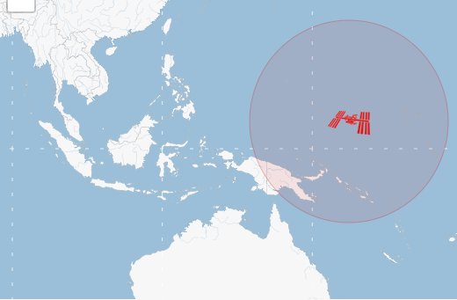
WHAT DID WE LEARN ABOUT API?
APPLICATION PROGRAMMING INTERFACE
HOW TO BUILD REQUESTS
HOW TO MAKE REQUESTS
STATUS CODES AND AUTHENTICATION
HOW TO HANDLE JSON DATA
HOW TO PARSE THROUGH NESTED DATA

Slide 7
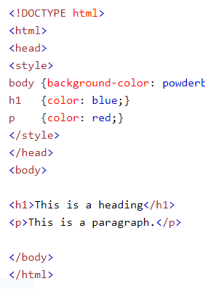
WHAT DID WE LEARN ABOUT WEB DEVELOPMENT?
WEB SERVERS
HOW TO HOST A WEB SERVER
BASIC HTML SYNTAX
BASIC CSS SYNTAX
HOW TO CODE YOUR OWN WEB PAGE
HOW TO CONNECT TO OTHER LOCAL WEB PAGES
BASIC KNOWLEDGE OF IP ADDRESSES
BASIC KNOWLEDGE OF NETWORK INFRASTRUCTURE

Slide 8
HIGHLIGHTS OF THE WEEK!
ADVENTURE BOOK PYTHON GAME
MORSE CODE TRANSLATOR
INTERNATIONAL SPACE STATION TRACKER
WEB SERVER AND WEB PAGE FROM HTML CODING
PYTHON MAD LIBS

Slide 9
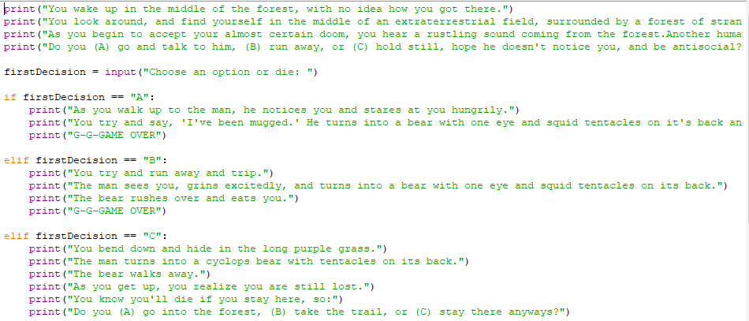

Slide 10
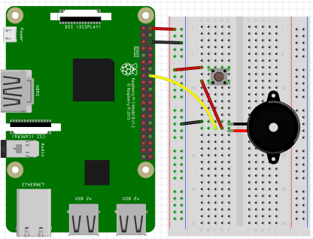
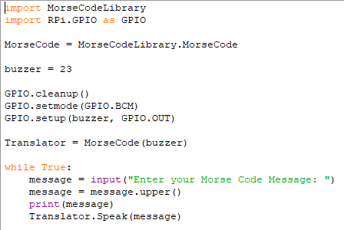

Slide 11
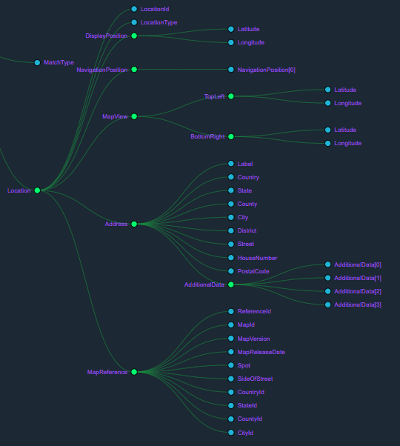
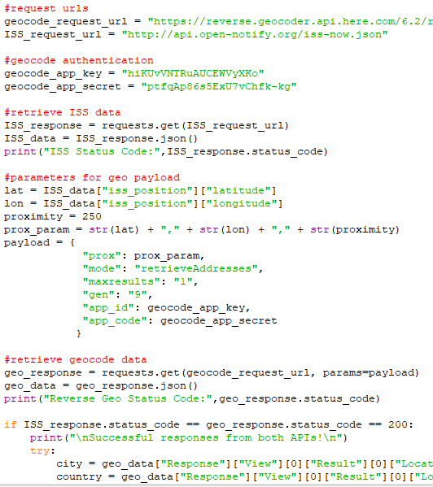

Slide 12
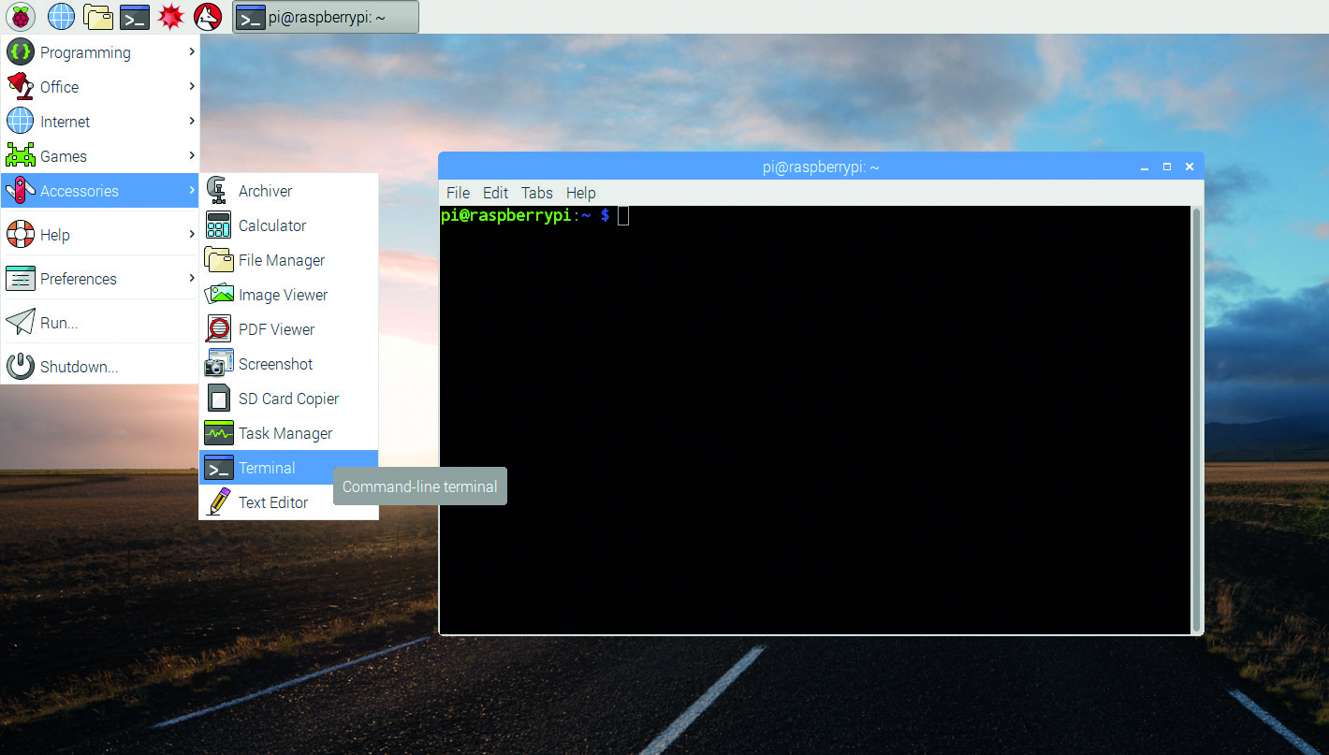
MISSION COMPLETE

